Slide 1
Wire-Framing

Slide 2
What Are Wireframes?
A wireframe is a model of your site without the coding and design. It can be used to test ideas for your UX project before you deploy expensive design and development resources. In general this tends to be a low-fidelity approach and won’t look too much like the end project.
Wireframes are screen sketches of a system, sometimes referred to as a blueprint or skeleton. They are created for the purpose of presenting and explaining system design ideas to customers, which ultimately leads to a general agreement on the ideas proposed.

Slide 3
What Are Wireframes?
Wireframes show "just enough" information associated with the feature proposed.
Each wireframe comprises basic graphic elements that represent the screen components, or the placeholders of screen components.
A wireframe depicts screen layout and how screen content is arranged.
It focuses on what a screen does and how users will interact with the system to achieve his need, instead of how the final screen will really look like

Slide 4
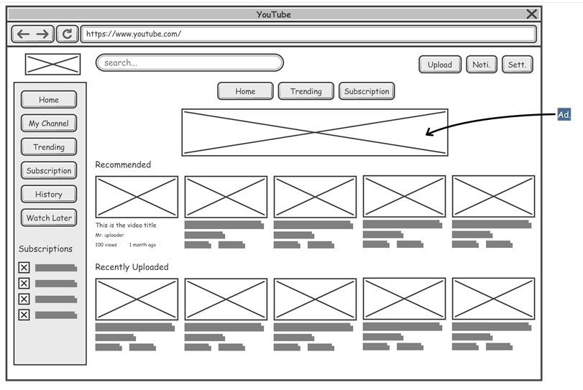
A wireframe created based on youtube.com

Slide 5
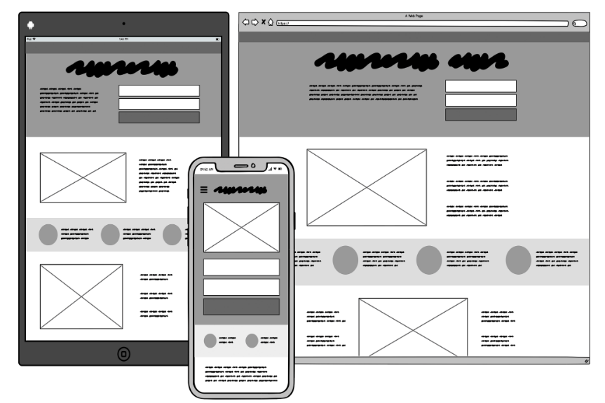

Slide 6
Why use wireframes?
The same screen can be built in a lot of different ways, but only a few of them will get your message across correctly and result in an easy-to-use software or website. Nailing down a good interface structure is possibly the most important part of designing software.
Doing this work now, before any code is written and before the visual design is finalized, will save you lots of time and painful adjustment work later.

Slide 7
Wireframe is only a blueprint
A wireframe is only a low-fidelity version of a user interface and are not meant to be a representation of real screen.
Wireframes are intended to be used to demonstrate the functionalities, user interactions and screen flows, without explicitly specifying how screen components should look like and how the components should behave in order to achieve the highest usability.

Slide 8
Benefits of using wireframe
Clarify user interface
Early consideration of usability
Cost-efficient
More willing to make changes
Engaged clients

Slide 9
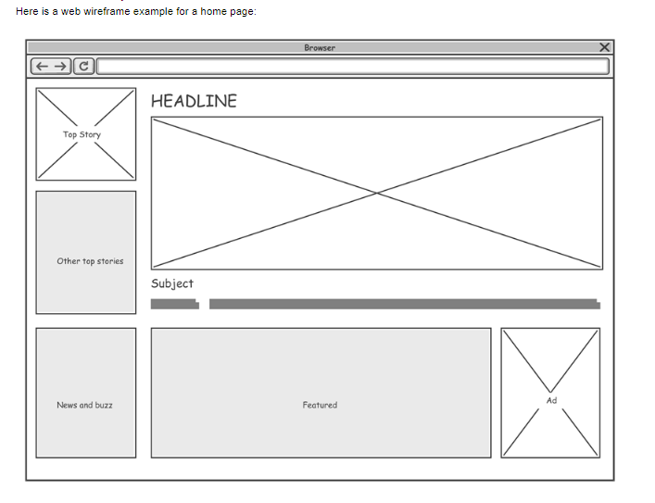

Slide 10
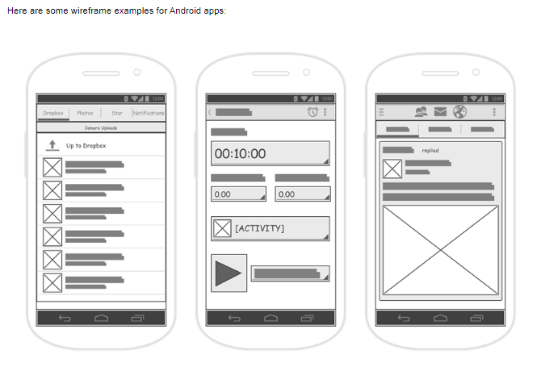

Slide 11
Difference between a sketch & wireframe
Sketch
Starting with the least detailed of the bunch, a sketch is a simple visual to help explain an idea quickly. There aren’t really any rules to follow here. Typically this is an idea that is in the beginning stages, with only a direction in mind, where frequent adjustments will follow.
Wireframe
Like a sketch, a wireframe is a way to illustrate information so that it can be understood quickly and clearly, at a glance. Decisions are still being made and ideas solidified so jumping right into the design wouldn’t be an efficient way to handle frequent changes. Besides, this isn’t a design exercise where colors and fonts are important, although the look and feel of layouts as it relates to the user interface (UI) play a part.

Slide 12
Reference:
https://www.visual-paradigm.com/learning/handbooks/agile-handbook/wireframe.jsp
https://balsamiq.com/learn/articles/wireframing-phases-ideation-validation/

Slide 13
MODEL-VIEW-CONTROLLER

Slide 14
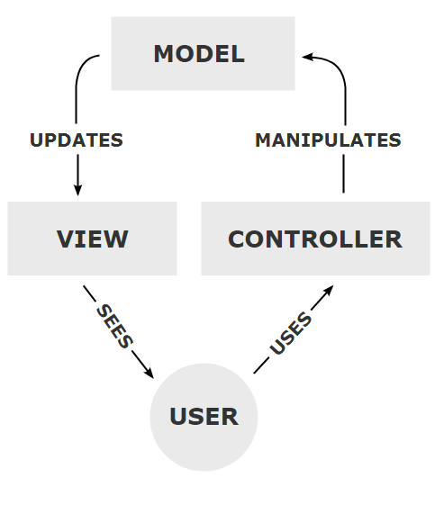
The Model-View-Controller (MVC) is an architectural pattern that separates an application into three main logical components: the model, the view, and the controller.
Each of these components are built to handle specific development aspects of an application.
MVC is one of the most frequently used industry-standard web development framework to create scalable and extensible projects.

Slide 15
Components:
Model:
The Model component corresponds to all the data-related logic that the user works with.
This can represent either the data that is being transferred between the View and Controller components or any other business logic-related data.
For example, a Customer object will retrieve the customer information from the database, manipulate it and update it data back to the database or use it to render data.

Slide 16
Components:
View:
The View component is used for all the UI logic of the application. For example, the Customer view will include all the UI components such as text boxes, dropdowns, etc. that the final user interacts with.
Any representation of information such as a chart, diagram or table. Multiple views of the same information are possible, such as a bar chart for management and a tabular view for accountants

Slide 17
Components:
Controller:
Accepts input and converts it to commands for the model or view.
Controllers act as an interface between Model and View components to process all the business logic and incoming requests, manipulate data using the Model component and interact with the Views to render the final output.
For example, the Customer controller will handle all the interactions and inputs from the Customer View and update the database using the Customer Model. The same controller will be used to view the Customer data.

Slide 18
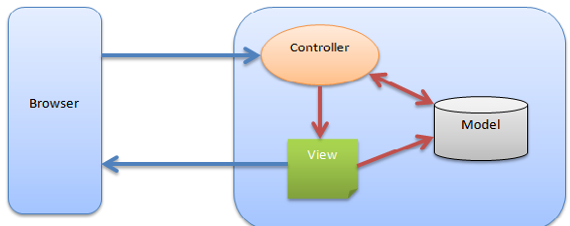

Slide 19
In addition to dividing the application into these components, the model–view–controller design defines the interactions between them.
The model is responsible for managing the data of the application. It receives user input from the controller.
The view means presentation of the model in a particular format.
The controller responds to the user input and performs interactions on the data model objects. The controller receives the input, optionally validates it and then passes the input to the model.
As with other software patterns, MVC expresses the "core of the solution" to a problem while allowing it to be adapted for each system.

Slide 20
Service:
Between the controller and the model, a layer called a service is sometimes interposed.
It fetches data from the model and lets the controller use the fetched data.
This layer allows a cleaner separation of data storage (model), data fetching (service) and data manipulation (controller).
Since this layer is not part of the original MVC concept, it is optional, but can be useful for code management and reusability purposes in some cases.

Slide 21
Reference:
https://www.tutorialspoint.com/mvc_framework/mvc_framework_introduction.htm

